Slide 1
Mastering Blockchain Third Edition
Chapter 11, Ethereum 101

Slide 2
Outline
The Ethereum network
Components of the Ethereum ecosystem
The Ethereum Virtual Machine (EVM)
Native contracts

Slide 3
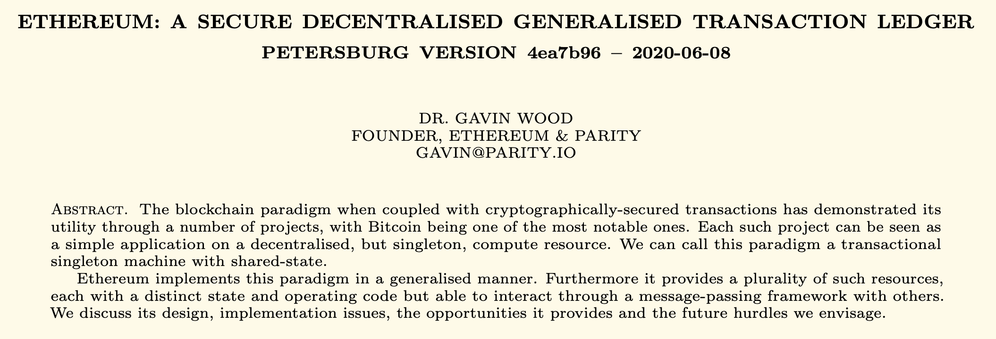
Ethereum – an overview

Slide 4
The Ethereum blockchain
On the Ethereum blockchain, a genesis state is transformed into a final state by executing transactions incrementally. The final transformation is then accepted as the absolute undisputed version of the state. Below, the Ethereum state transition function is shown, where a transaction execution has resulted in a state transition.

Slide 5
Ethereum – a user's perspective
The most common use case for the Ethereum chain is to send or receive payments
To do so, the user signs the transaction and submits it, which propagates on the network, at which point miners pick it up, verify it, and begin Proof of Work (PoW). If PoW is successful, the block with the transaction is finalized and propagated, and a new block is added to the chain
To send and receive transactions, wallet software is used: for example, mobile wallets are used on mobile devices

Slide 6
Ethereum’s high level architecture

Slide 7
Elements of the Ethereum ecosystem
Keys and addresses
Accounts
Transactions and messages
Ether cryptocurrency/tokens
The EVM
Smart contracts and native contracts

Slide 8
Types of accounts
EOAs: Externally Owned Accounts. User accounts represented by an address
CAs: Contract accounts. Created as a result of deployment of a smart contract—also represented by an address

Slide 9
Transaction and transaction trie
A transaction in Ethereum consists of a number of fields, as shown here, along with transaction trie. The diagram also shows the relationship between the transaction trie and the block header.

Slide 10
Types of transactions
There are three types of transactions:
Contract creation
Call
Value transfer
The diagram shows contract creation and message call transactions, with required fields

Slide 11
Account state and storage trie
The diagram shows the fields contained within the account state, and how the various elements are contained within the world state trie:
World state trie
State root
Account state
Account storage trie

Slide 12
Transaction receipts
Transaction receipts are generated as a result of a transaction execution
Logs are also updated accordingly
Both data structures contain several fields, as shown below:

Slide 13
The Ethereum Virtual Environment (EVM)
Stack size based on LIFO queue: Last In, First Out.
1024 stack depth limit
Turing complete but limited by gas, making it quasi-Turing complete
Big-endian design
Storage available to EVM
Memory
Storage
Stack

Slide 14
EVM operation design

Slide 15
Execution environment
Ethereum’s execution environment consists of several elements, as shown here:

Slide 16
Machine state
Machine state is a tuple comprising several fields, as shown here:

Slide 17
Native contracts
There are nine precompiled contracts or native contracts in the Ethereum Istanbul release:
The elliptic curve public key recovery function
The SHA-256-bit hash function
The RIPEMD-160-bit hash function
The identity/datacopy function
Big mod exponentiation function
Elliptic curve point addition function
Elliptic curve scalar multiplication
Elliptic curve pairing
Blake2 compression function 'F'

Slide 18
Exercise
Read the Ethereum yellow paper: https://ethereum.github.io/yellowpaper/paper.pdf

Slide 19
Summary
In this presentation, we explored:
The Ethereum network
Components of the Ethereum ecosystem
The Ethereum Virtual Machine (EVM)
Native contracts

